Slide 1
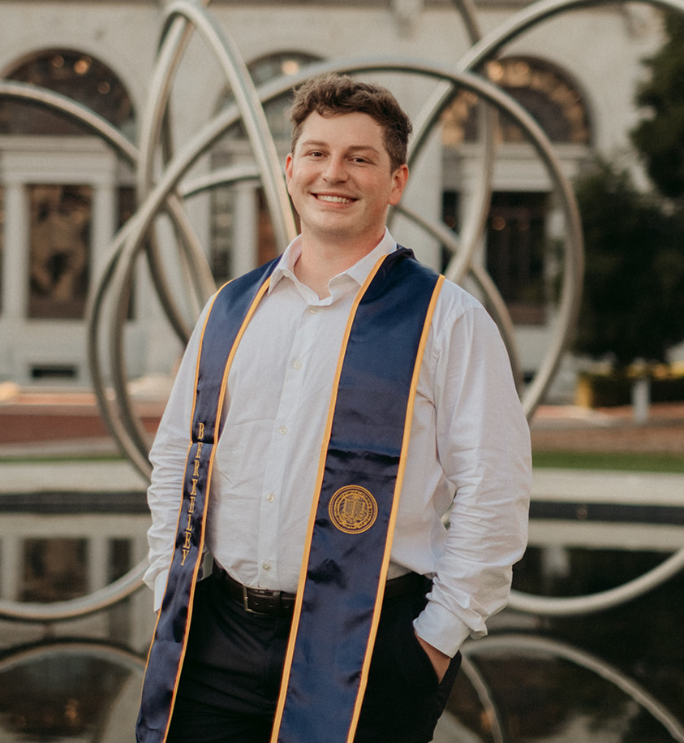
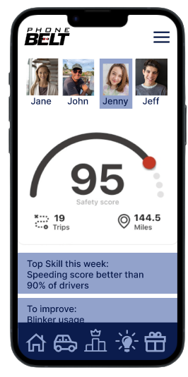
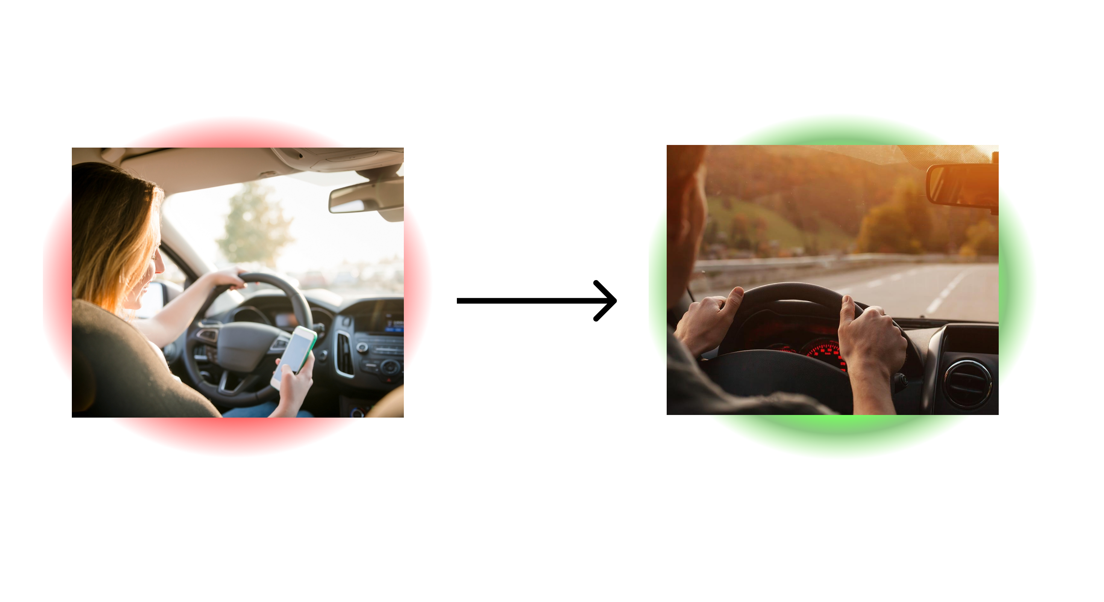
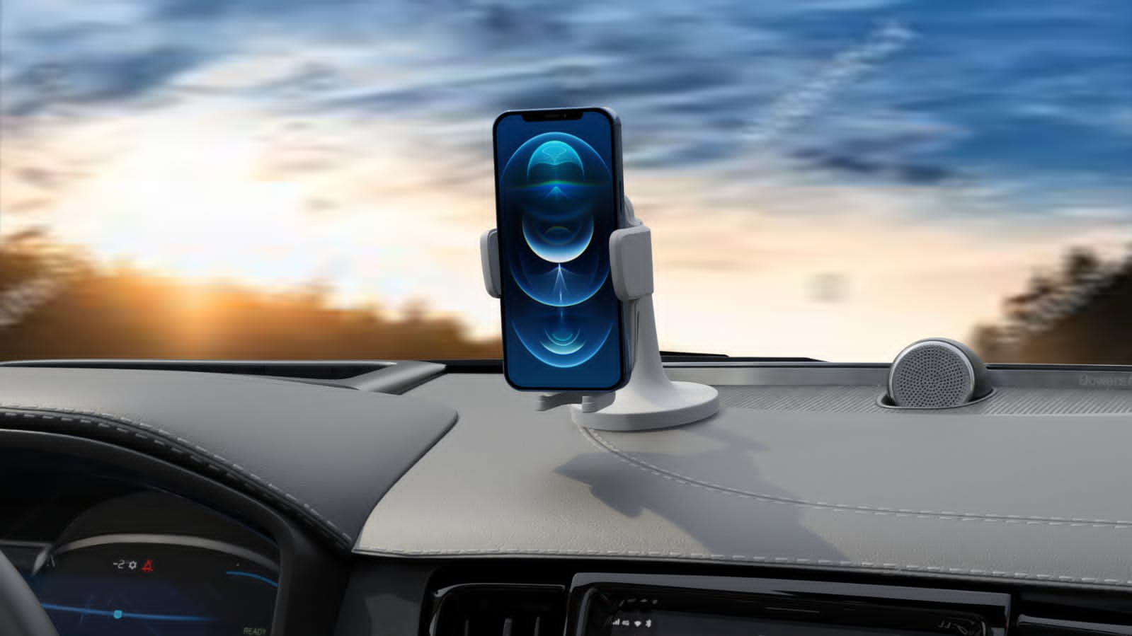




PhoneBelt
Date 08/16/23
Business Thesis:
We help budget car insurers acquire customers and provide car insurance sourcing help to consumers
James Coleman
 | Interview count
Since last meeting | 7 | 2 |  | 5
Total | 30 | 19 | 6 | 5
5

Slide 2




Initial Business Model Canvas: way too broad
Key Partners Driving schools Gov agencies that promote safe driving or involved with driving at all (DMV) Distracted driving related charities, foundations and non-profits School districts hosting distracted driving awareness week/ red ribbon week & districts that allow students to purchase on-site parking passes Community safe driving advocates. Government officials Occupational safety organizations/ government arms Parenting social media platforms and their moderators Existing indirect competitors or companies in this space that are willing to collaborate in mutually beneficial ways | Key Activities Build product Talk to customers Find and apply to grants Add workers or cofounders | Value Propositions Parents: Provide parents the Maslov need of security and safety Reduce time spent checking on family members and reduce time spent coaching young drivers Potentially reduce insurance costs Teens Provide the tools to actionably improve driving Put money in your pocket and reward safer driving |  | Customer Relationships Initially a hands-on onboarding relationship Continually provide value to customer via ongoing solutions Offer lots of customer support to create ongoing relationship | Customer Segments Parents of teenage drivers, especially those using existing solutions like Life360 Rideshare drivers who cannot access UBI currently Commercial Door to Door driving, especially the ones that do not use a driver facing camera solution Car insurance companies and organizations Vehicle rental companies
 | Key Resources App developers Cash for building team Insurtech conference/ accelerators/ connections (industry and legal knowledge) Contract Manufacturer for hardware |  |  | Channels Earned media (novel and controversial product) Social media marketing Kickstarter Targeted selling through key partners Pilots with key orgs/ gov arms Paid acquisition via ads
Cost Structure Hardware Costs COGS (landed) - $15 SG&A – $10 Certification costs (12k) App costs Cloud computing and storage costs (Storage, Inbound, Outbound, Compute per gig TBD) |  |  | Revenue Streams Freemium subscription model {free, silver, gold}

Slide 3
What we thought our business opportunity was:
Far too broad. Many businesses with many different distribution and sales channels. No homogeneity.
Then we picked a beach head market that we thought was the best. Consumer facing driver monitoring.
Customer discovery proved that was not the beachhead market
Learned that the commercial driving market and consumer insurance markets are the head on fire customer purely through our conversations with customers

Slide 4
What we did to test our assumptions
Most importantly picked a beachhead market. Being too general was a huge recurring problem
Wrote out the assumptions we were making
Phrasing things in ways that are value propositions and trigger responses out of customers is far more valuable than talking about the tech – that turns people away
Asked open ended questions and really pushed for the customers to tell us stories not answers
One really amazing interview was with a UPS manager. We first talked about driver monitoring in the context of his home. He then mentioned how the UPS union negotiations led to ban on driver facing cameras which in the context of commercial driving is our most direct competitor. We learned that UPS, one of the largest fleet owners cannot use the product we are competing against
Our initial conversations talking about Life360 and data privacy led us to the pains and data privacy issues of car insurers not having their best interests at heart. This led us to the conclusion that the insurance industry really needs some disruption

Slide 5
What we learned:
The better you understand your customer the better you know your business
Driver safety and coaching is a nice to have but a “gain” not a “pain”
The car insurance process is a big pain
People feel their insurers don’t have their best interest at heart and will do anything to get out of a claim
There is very little trust in car insurers except oddly AAA
People with big pain points are teen drivers on their own policy, parents of teen drivers who have their kids on their policy, and people who recently got into car accidents\
In summary, people who drive well but are considered risky due to their risk pool

Slide 6
Key Partners Driving schools Gov agencies that promote safe driving or involved with driving at all (DMV) Distracted driving related charities, foundations and non-profits School districts hosting distracted driving awareness week/ red ribbon week & districts that allow students to purchase on-site parking passes Community safe driving advocates. Government officials Occupational safety organizations/ government arms Parenting social media platforms and their moderators Existing indirect competitors or companies in this space that are willing to collaborate in mutually beneficial ways Who will help you? | Key Activities Build product Talk to customers Find and apply to grants Add cofounders/ employees How do you doit? | Value Propositions We provide parents the feelings of child protection while they are not physically with their teen Reduce the time parents spend time calling to check on their teen Allow parent to allocate their time and parenting to their teens that need additional help behind the wheel The peace of mind knowing their child has the tools to improve their safety behind the wheel We provide parents relief by allowing them to visualize their teen’s improvement What do you do? |  | Customer Relationships Hands off onboarding at scale Continual support through the app and the ability to talk to a rep Incentives to share the app with their friends and social media How do you interact? | Customer Segments Parents of teenage drivers, especially those using existing solutions like Life360 Who do you help?
 | Key Resources App developers Cash for building team Insurtech conference/ accelerators/ connections (industry and legal knowledge) Contract Manufacturer for hardware What do you need? |  |  | Channels Earned media (novel and controversial product) Social media marketing (working with bloggers, vloggers, reviewers, as well as our own content) Kickstarter Driving sales/ attention with driving schools and other partners Ad campaign aimed at life360 users Friend Referrals How do you reach them?
Cost Structure Hardware Costs COGS (landed) - $15 SG&A – $10 Certification costs (12k) App costs Cloud computing and storage costs (Storage, Inbound, Outbound, Compute per gig TBD) What will it cost? |  |  | Revenue Streams Freemium subscription model {free, silver, gold} Ex: $10 MRR per customer How much will you make?
Notes:
HANDOUT 1: BMC

Slide 7
What we plan to do next:
Continuously do customer discovery and learn from customers
Continue learning more about the commercial markets while synchronously building the technology
Use mockup software to cheaply iterate and get feedback with customers along the way
Test markets using social media to find interest

